Slide 1
Microservices Practice
Description: UST Global Microservices Go To Market Strategy
September 25, 2016

Slide 3

Microservices
Scale & adapt at the speed of business.
Microservices enable rapid innovation.
Simple, clean, consistent interfaces make it easy for your customers to start using your services right away.
Fewer dependencies let you focus on delivering essential value without worrying about the impact of changes.
As your business grows, microservices will scale right along with the business – never holding you back.
Smaller, completely independent components enable greater agility and scale.
Benefits
Innovate quickly
Create new revenue channels
Change and evolve safely
Achieve hyper-scale

Slide 4

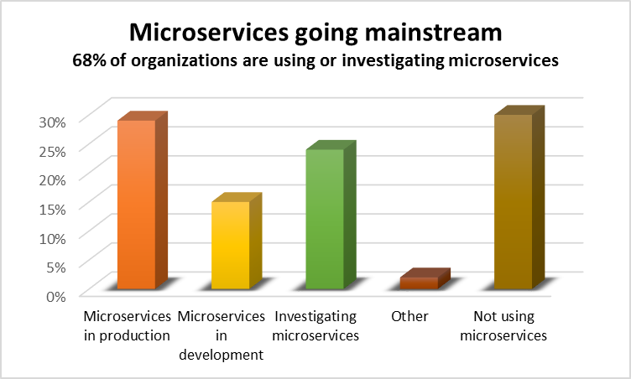
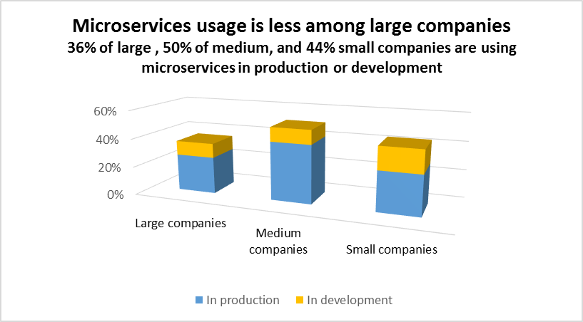
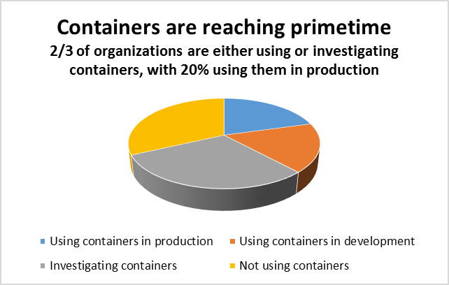
Microservices: Trends

Slide 5



























Microservices: Early Adopters
Well-known vendors using and contributing to this new paradigm
Well-known Businesses using Microservices Today

Slide 6

Microservices: Key Use Cases
Cloud-Native Applications Creating new cloud-native IT systems that are easy scale, repurpose, extend, and maintain
Evolution of SOA
Adapting existing services - complex, can't be easily changed & are slowing down the business
Legacy modernization
Clients want to skip legacy SOA phase of evolution and go straight to modern cloud-native architectures

Slide 7










Market Driving Forces
Speed, Scale, Agility, and innovation for the enterprise
Lower costs and improve resiliency
Improve the speed of change by reducing complexity
Create new services and revenue streams
Integrate among internal and external partners and vendors, securely and reliably
Microservice
Provide always-available services - limit the scope of any failure
Improve end-user experience and engagement
Integrate social and location-based technologies to improve targeted marketing
Improve demand forecast and planning
IoT integration and next generation ecosystems such as auto replenishment devices
24/7

Slide 8

Microservices: Clients facing challenges
Paradigm Shift
From technology focused teams to cross-functional, autonomous teams
The team manages complete lifecycle, including QA, deployment, runtime, and support
The team decides technologies, releases etc.
Significant Operations involved
A radical departure from traditional monolithic applications
Insist on standards of excellence but not how it’s done
Inertia due to
Fear of getting stuck with the wrong technology
Microservices architecture is much more complex than legacy systems
How to handle deployment patterns and deal with dependencies
Service configuration, maintenance, and operations becomes challenging due to volume
Logging across multiple platforms
More granularity – more moving parts - increased complexity, more points of failure, and more opportunities for hackers, crackers and criminals

Slide 9

UST Global Microservices Practice
Services
Strategy & Architecture
Guidance and strategy to build a foundation for success.
Microservices JumpStart
Proven process, frameworks, and tools to get moving quickly.
Design & Engineering
Next-generation microservices built for scale.
Service Portfolio Design
Deployment Strategy
Automation Strategy
Testing Strategy
Security Strategy
Operations Strategy
Proven Patterns & Practices
Tools & Frameworks
Reference Implementations & Templates
Continuous Quality automation
Deployment automation
Design & Development
Testing & Quality Management
End-to-end Automation

Slide 10










Current Clients
Currently Pursuing Opportunities

Slide 11

UST Global: Capturing Additional Opportunities
Clients are saying "We're ready to do microservices -
can you give us a team?
a methodology?
can you run it for us?“
To fulfill the demand today,
we need to go to market and get people,
Long sourcing lead times (>3 months)
Still need to train after that
Need to make strategic investments to become more responsive to customer demand
Typical initial opportunity size: $350-700K just to get started (small team in the door on day 0)
Typical 1 year opportunity size: $2-3MM for larger team to deliver big portfolio of microservices
Out of current opportunities, probably leaving on table $3-5MM right now.

Slide 12

UST Global: Ramp up Strategy
Training, Training, Training
convert utility developers into specialized microservices and related cloud technologies experts
Effective training of existing resources to produce:
Experts in microservices
Related cloud technologies and methodologies
We can utilize our training partners:
Global Mentor
DataStax
Nginx
Pivotal
GE (IoT)
Amazon
Result:
Charge premium rates for these experts vs. commodity labor rates
For example - difference can be $30/hr. for commodity developer vs $45-$75/hr. remote for certified developers

Slide 13
Microservices: Capability Development Plan
Microservices Certifications
Architects – 5
Focused Trainings
Internal by Custom Build Team
Vendor-offered Trainings
Publications
2 Whitepapers/quarter
Conference papers
Developers - 20

Slide 14
Implementation Roadmap
0 - 3 Months
4 - 6 Months
7 - 9 Months
Standardize on microservices tools, frameworks, and solutions
Train initial set of microservices developers &
architects
Short-duration prototypes & POCs for clients across multiple verticals
Larger and longer strategic engagements focused around microservices
Develop strategic case studies, collaterals & POVs
Opportunities to bring strongly differentiated UST branded microservices tools & products to market
Form & train additional microservices feature teams
Build & Operationalize microservices COE in UST

Slide 15

Microservices: Investments Required
Areas | Details
Training & Certifications | Certifications, training Application Platforms: Pivotal Cloud Foundry, Red Hat OpenShift Container Orchestration Platforms: Kubernetes, Mesos Microservices Methodology & Best Practices Sourcing for more specialists AWS & Azure, Private Cloud (OpenStack)
Sourcing | Architects Developers Skill Sets: Cloud Foundry, OpenShift, REST API Security, Kubernetes, Amazon ECS, IoT, Node.Js, Spring Cloud
General | Methodology & Solution Accelerators Publications Microservices Sales Training Product & Service Offering Maturity

Slide 16

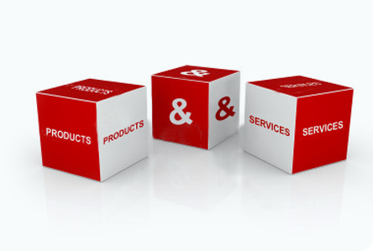




Microservices: Partners & Products
Partners can possibly be engaged
Bundling opportunities can be created and explored
Agile, DevOps
Cloud
Big Data
Mobility
Legacy Modernization
Upsell opportunities for CyberEdge

Slide 17
Clients are screaming for help
UST has the right key resources
A pragmatic and conservative approach will be adopted to convert utility developers into specialized microservices and related cloud technologies experts
The practice will grow internally and seek external help only when necessary
Revenues generated from current engagements will be used to provide necessary training, develop collateral, conduct research, create frameworks, reusable assets, and products
The engagements will yield us much needed revenues, case studies, references, credibility, and experience
We’re missing out on $3-5MM opportunities right now
The practice could grow out to be $7 – 10MM per year within next 12 – 18 months
Key Takeaways

Slide 19
Microservices: Our Team
Varghese Cherian
Technology Build Services
Prashanthjee Sasidharan Pillai
Java, SOA, Integration
Dave Cheema
Enterprise Architecture, TOGAF
Enterprise Architecture
Custom build Services
David Lazar
Cloud Strategy
Architecture Microservices
Cyber Security
Dr. Adnan Masood
Data Science
Dr. Raghu Pushpakath
Cloud Practice
Gregory Beamer
Solutions Architecture
AI
Machine Learning
Eric Roenker
UST Consulting’s
Modernization Practice
Mahesh Bhaskar
GE
Sakthivel Rajendran
Aravind Nandanan
EMC/Dell
T-Mobile
Jay Desai
Macquarie
Santander
Anthem

Slide 22
Appendix

Slide 23

Market Driving Forces: Banking & Financial Services
Acquire partners specializing in niche FinTech services
Seamless integration with crowdfunding platforms, payment splitting apps
Create new revenue streams by monetizing partner resources
End users experience a new breed of services tied into their accounts
Break up a system into a number of interconnected services and each one specializing in a very specific task
Developers utilize the power and knowledge of banks to create new innovative services
To lower costs and improve resiliency

Slide 24

Market Driving Forces: Energy & Utilities
Enable quick change to handle unplanned events
Elastic scalability to handle demand elasticity
Specialized services for specialized tasks
Demand forecasting & capacity planning
Extreme levels of availability
Repurpose existing assets into reusable components

Slide 25

Market Driving Forces: Retail
Integrate social and location-based technologies to improve targeted marketing and provide more real-time personalized messages, offers and promotions.
Harness the power of biometrics to deliver zero-friction ecommerce transactions
Drive improvements in customer experience through a mobile-first retail strategy
Leverage a broad array of in-store technologies to draw consumers in the door and increase customer engagement
Track and manage inventory in real-time
Enable new opportunities through IoT integration and next generation ecosystems such as auto replenishment devices

Slide 26

Market Driving Forces: Healthcare
Create Self-service portals that allow patient themselves to schedule visits
Manage and scale apps independently across diﬀerent instances, all sharing one central database
Allow booking appointments by healthcare providers with each other
Enable patient history sharing among providers, e.g., operations or medical conditions
Avoid multiple entries into multiple databases for the same patient
Access births, deaths, operations and disease diagnoses data for resource capacity planning or react to shortages

Slide 27

Market Driving Forces: Hi-Tech
Need high agility and innovation for the enterprise
Improve the speed of change by reducing complexity for safer evolution
Require massive scalability - Netflix handles 1 billion calls per day
Deploy certain business functions independently
Provide high automation in CI/CD to change at the speed of business
To provide highly resilient systems
To enable digital transformation by integrating and interacting with vendors and partners

Slide 28
Market Driving Forces: Media & Entertainment
Speed of innovation – release independent features faster and more often
Always-available services - limit the scope of any failure; automatically recover from failures by redeploying a failed component.
Easier continuous integration and continuous delivery
Finer grained scalability
Web scale - containers enable incremental scaling microservices
Speed/Agility - 400% faster on new platform
Do more with less - Hard Savings: $1.1M per application update delivered

Slide 29

Market Driving Forces: Telecommunications
Speed, Scale, Agility
Deliver a quality product in the shortest time possible
Product constantly evolving; “feature complete” a moving target.
Handle new requirements, integrating with partners, navigating the intricacies of business in various regions
Need to execute and scale to meet growing demand internally and externally
Change of speed is slow; teams struggle to execute in parallel
Handle occasional extreme traffic spikes
The company being limited by itself than the market or competitors

Slide 30
Microservices Team

Slide 31
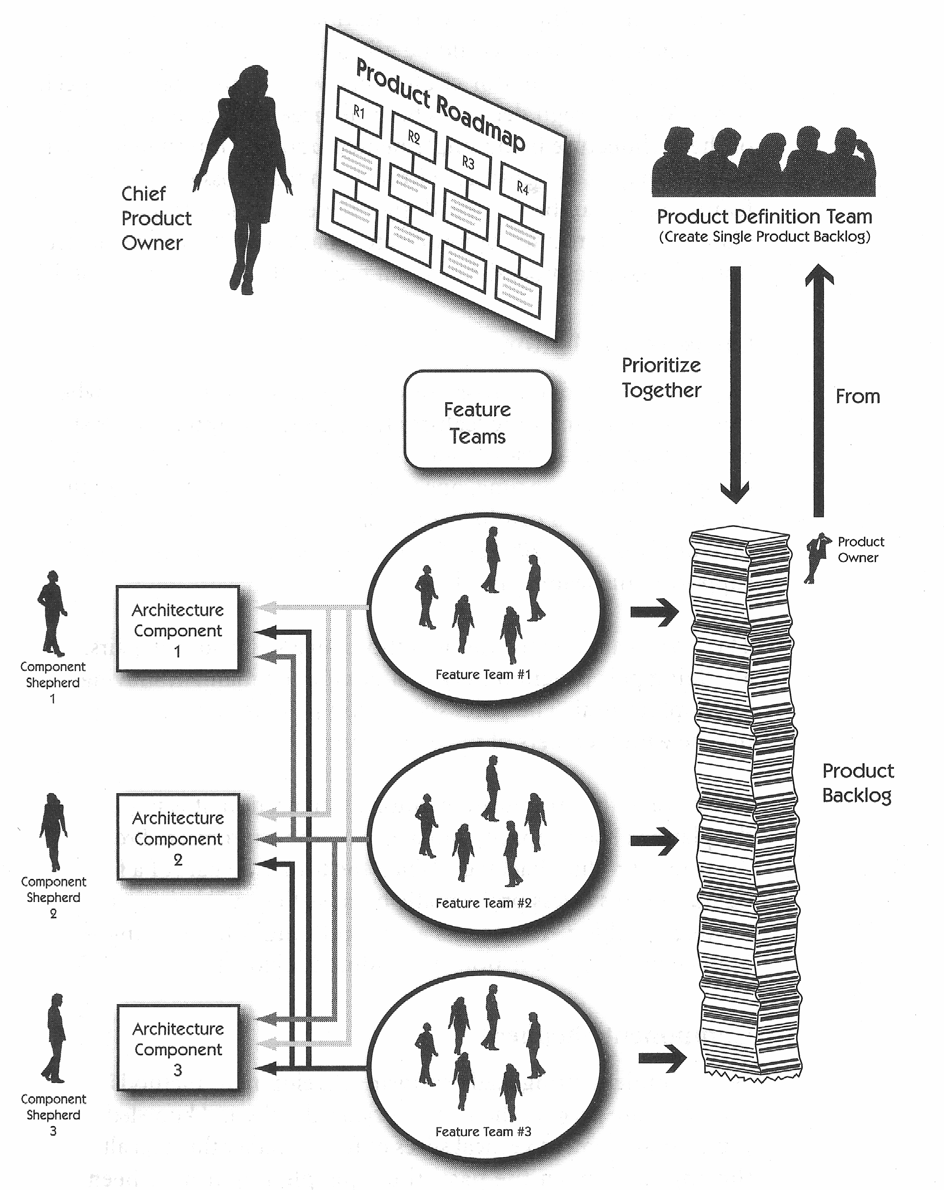
sformation Process
Microservices: Team
“Feature Team” structure
Uses common Product Backlog Integration is done in parallel
Requires high levels of communication across teams to resolve integration issues
Forces Product Owners to be more coordinated
Sprints should be synchronized
Cross team fertilization is a requirement to successfully deliver in parallel
31

Slide 32


Microservices Transformation Process
Microservices: Team Size
Two-pizza Teams
Full ownership
Product planning (roadmap)
Development work
Operational/Client support work
Full accountability
You build it, you run it
“DevOps”
Aligned incentives
32

Slide 33
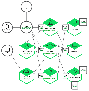



Microservices: Team Structure
Responsibilities:
Key role – master of everything
Cloud, Microservices, and Java design and dev. best practices
SME in Microservices development and deployment
Skillsets:
Cloud Foundry expertise
Containerization
DevOps Automation - CI/CD
Setup tools, assets, APIs repositories
Modern software paradigm, e.g., SPA
HTML5, CSS3, Bootstrap, and AngularJS
Responsibilities:
Hands-on, lead engineering team to create cloud-native solutions
Iteration planning, managing and coordinating product and iteration backlog
Acceptance criteria development for complex
Skillsets:
Expert level knowledge of agile development
Experience with Cloud Foundry, Java EE, DevOps, CI/CD
HTML5, CSS3, Bootstrap, and AngularJS
User story elaboration
Expert understanding of API design principles
Microservices Team
Microservices Architect
Technical Product Owner (TPM)
Software Dev Engineers in Test (SDETS)
Software Dev. Eng. (SDE)
Responsibilities:
Develop defined Microservices
Develop tests – unit, integration, acceptance, consumer-driven contracts
Support Quality Assurance efforts
Skillsets:
Agile development
Cloud Foundry, Java EE, DevOps, CI/CD
HTML5, CSS3, Bootstrap, and AngularJS
Solid understanding of microservices architectures, challenges, and solution patterns
RESTful API design and implementation
Fluent in TDD, BDD, ATDD
Responsibilities:
Functional and non-functional testing of Microservices, APIs, and cloud native solutions
Guides overall test methodology and best practices
Skillsets:
Similar skills and background as Software Dev Engineer
Specialty in automated and manual testing
Mentor automated testing practices in a cloud native solutions architecture
Validate software against specifications
Setup and configure various environments
Create and execute automated tests against complex microservices architecture

Slide 34
Microservices Ecosystem

Slide 35
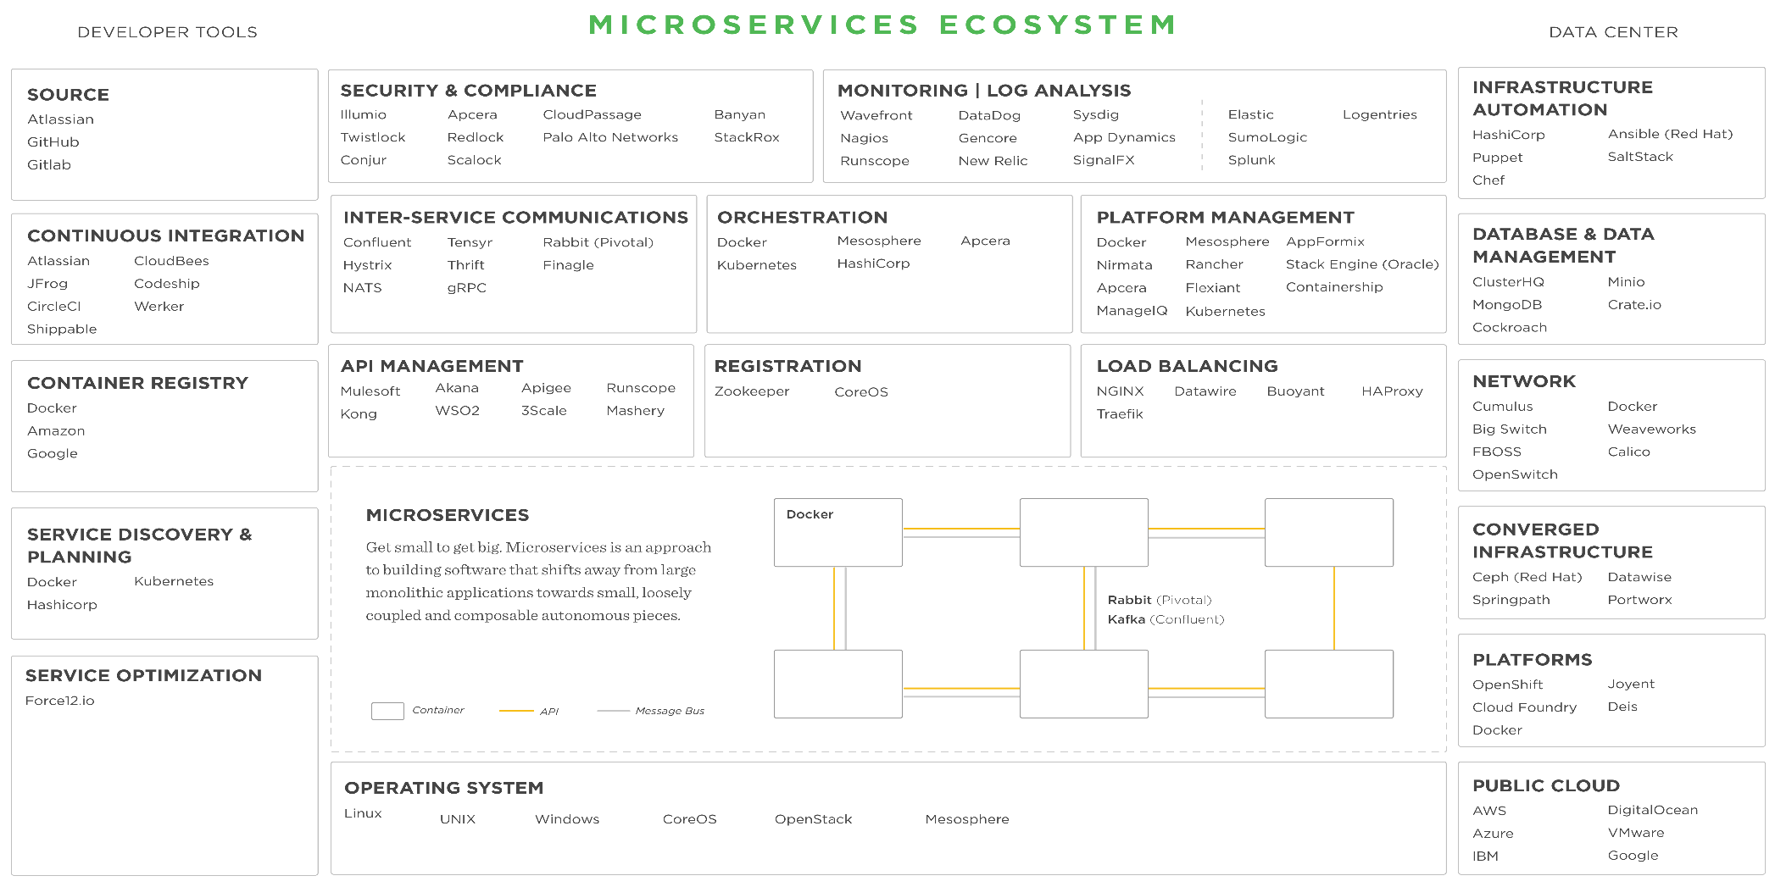
Microservices Transformation Process
Microservices: Ecosystem
35

Slide 36
UST Global: Monolith to Microservices Transformation Process

Slide 37
Microservices: Platform Vision
Current State
Future State
APIs enable
Integration and automation of interactions
Automating reactions to alarms, trends, and events
3rd-party developers to create innovative solutions
Microservices architecture enables:
Rapid, low impact evolution & replacement
Robust fault isolation
Deployment automation & flexibility
On-Demand Scalability
Small Testing Scope
Simple Optimization
Flexible Versioning
Shortened time-to-value
Standardized platform services enable and simplify:
Security management
API Subscription management
Usage Metering
Chargeback & Billing
Cost efficiency is improved by leveraging cloud computing economies of scale and reducing the need to manually operate and maintain server infrastructure
UI
UI
Application Services Layer
APIs
Middle Tier Application
Code
Micro
services
Data Services
Platform Services
Backend Dependencies
Backend Dependencies
Infrastructure
X
X
X
X
X

Slide 38
Microservices Journey
Current
Modernized
Prep for Strangulation
Monolith Strangulation Method
Stop building the Monolith
New features/products and changes developed as microservices
No change on Monolith to allow for atrophy
Split frontend and backend
Active modernization of capability to microservice architecture
Extract Services
Active modernization of domain to microservices architecture
Top-Down
Leverage legacy investments
Business Rules
Possible End State
Fully Modernized
Side by Side
Extract services to modern platform

Slide 39
Microservices Transformation Process
Microservices: Transformation Process
Current Monolithic System
Extract “vertical slice” of application functionality
Microservices Platform
1
Platform Security
2
UI
Package as Microservice(s)
API Security
API Layer
Microservice 1
Microservice 2
Microservice n
Application Services Layer
UI
UI
UI
Expose functionality through APIs
APII
API
API
4
Logic
Logic
Logic
Data
Data
Data
3
Deploy on Microservices Platform
Microservice 1
Microservice 2
Microservice n
Middle Tier Application
Code
$
…
Usage Metering
Billing & Chargeback
Data Services
Platform Services
Backend Dependencies
Backend Dependencies
Infrastructure

